Slide 1
The Breakout Game Using Pygame Library
Presented by
Syed Nazmus Sakib
Associate AI Engineer
Next Solution Lab

Slide 2
Outline
Introduction and Demo
Features
Limitations
Future Implementations

Slide 3
Introduction
Breakout is one of the earliest arcade video games, first released in 1976 by Atari. It was derived from the game Pong (released by Atari in 1972).
This one-player game features simple 2D graphics.
It consists of one paddle used to return a bouncing ball back and forth across the screen.
The aim of the game is to break the bricks of a brick wall by getting the ball to hit/bounce on the bricks.
The score correspond to the number of bricks being hit.

Slide 4
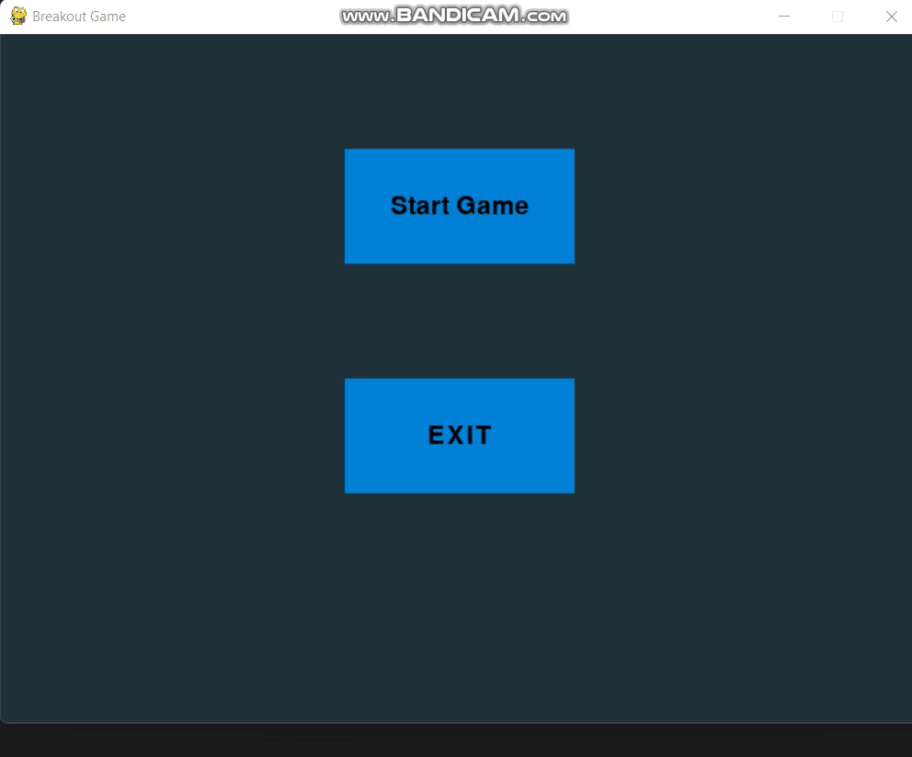
Demo

Slide 5
Features
User friendly UI.
Game window size can be changed. Game objects are responsive to size.
Paddle can shoot the bricks.
Paddle can move up, down, left right.
Bricks keep going down after some frames interval
Balls are doubled if hit some special bricks.

Slide 6
Limitations
Full screen view feature not implemented.
Difficulty levels are not defined.
Future Implementation
Choose difficulty level at the start
Solve full screen view issue.
Build an AI bot to play the game using Q learning

Slide 7
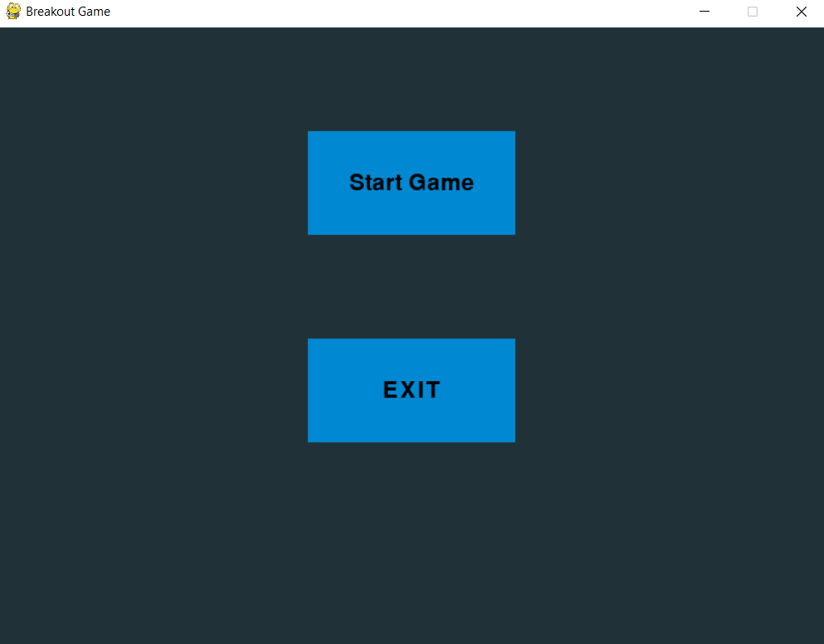
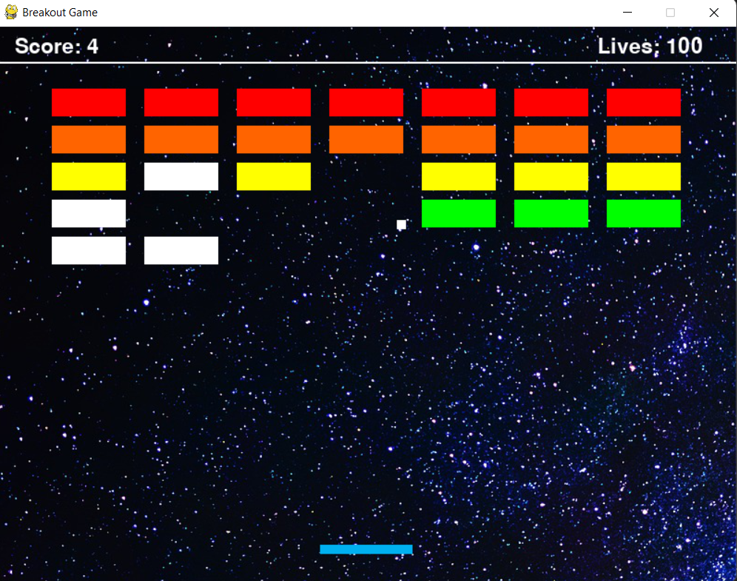
User friendly UI

Slide 8
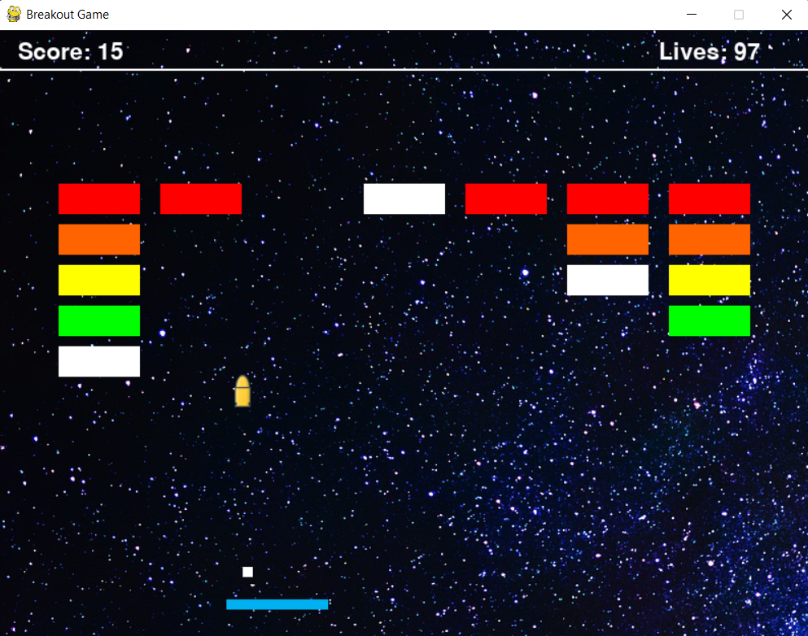
Paddle can shoot the bricks.

Slide 9
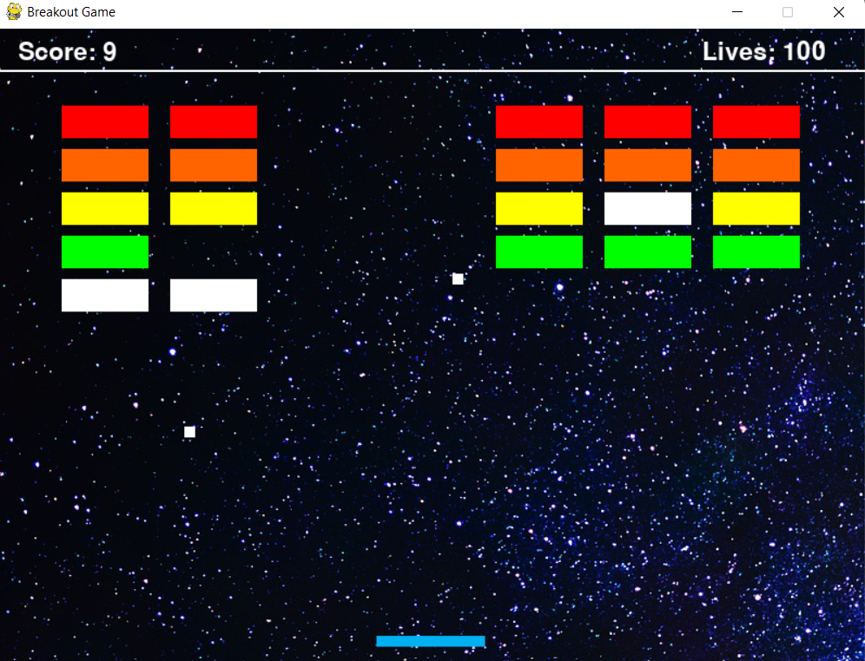
Multiple balls when hit some special bricks

Slide 10
Thank you
Feel free to ask questions

